Slide 1
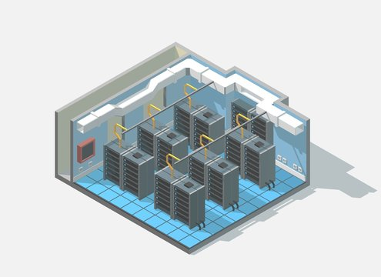

Slide 2
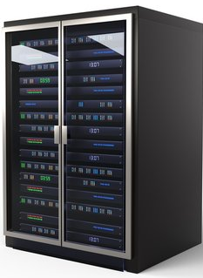
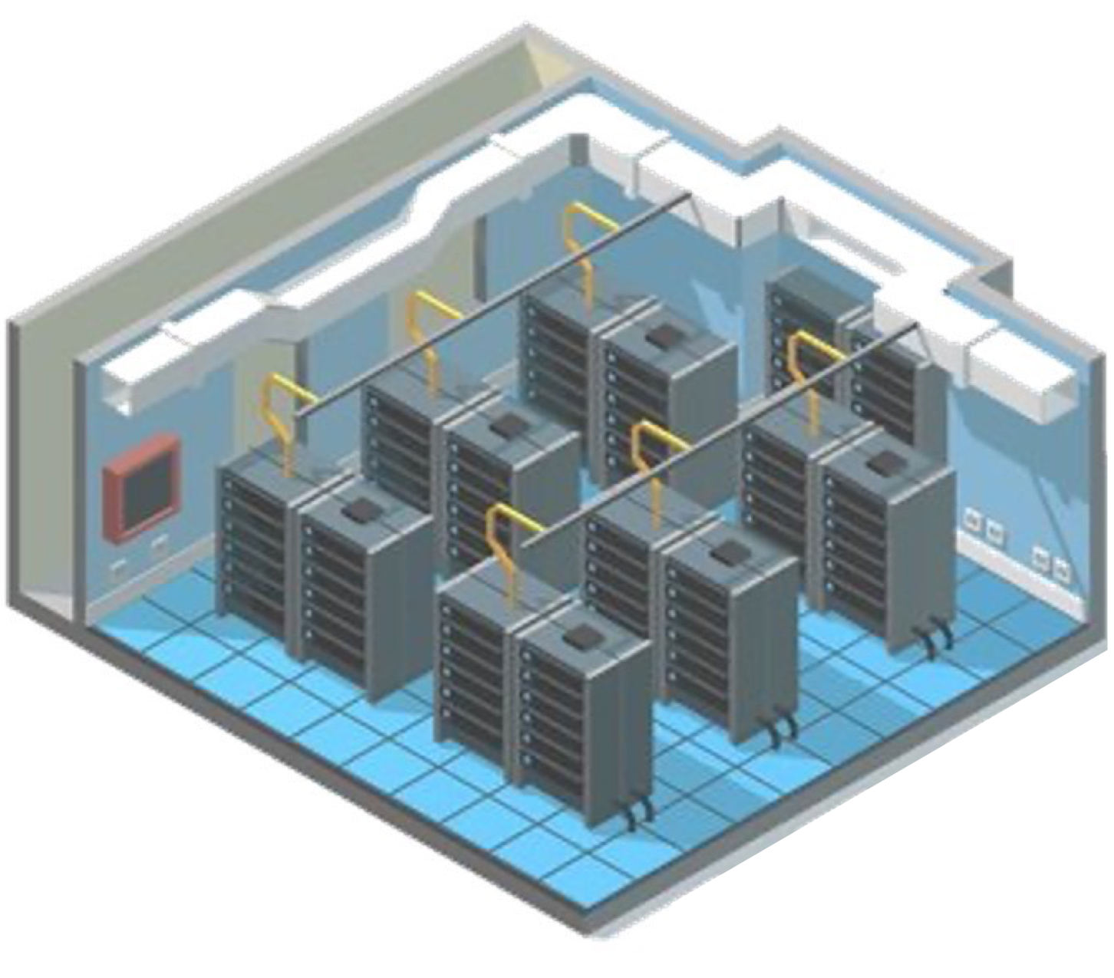
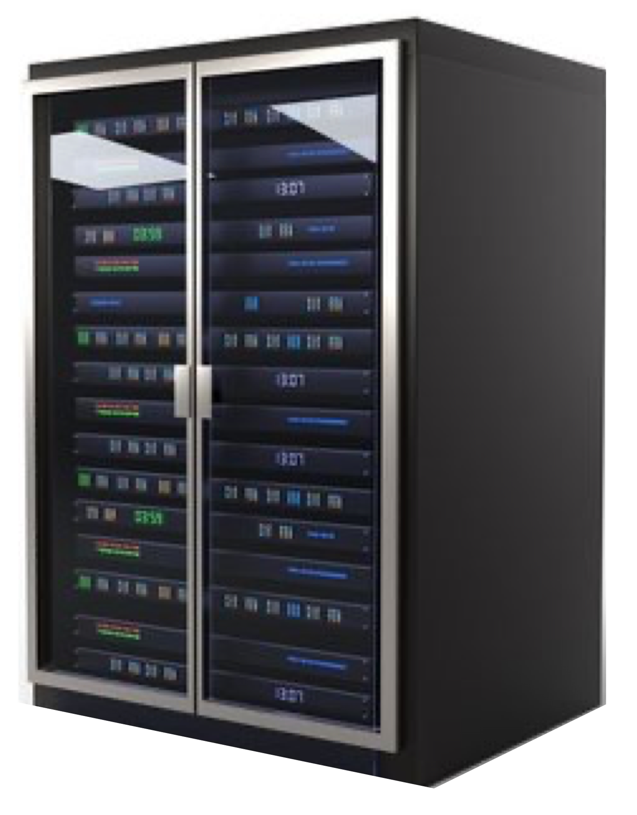

Slide 3









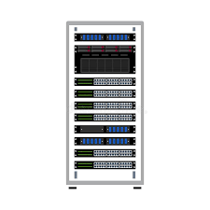



Local “Networked” Services
Linux / Containers / Container Managers
Virtual Machines
Edge / IoT Devices
Mobile Compute
Local Compute
Last Mile Networks
Cloud Edge Locations
Cloud Regional Datacenters

Slide 4
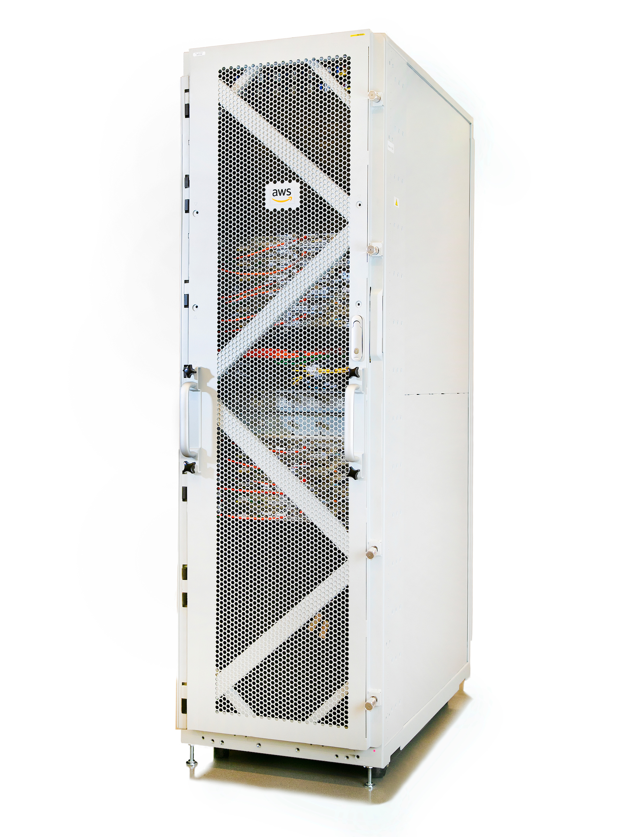

Slide 5
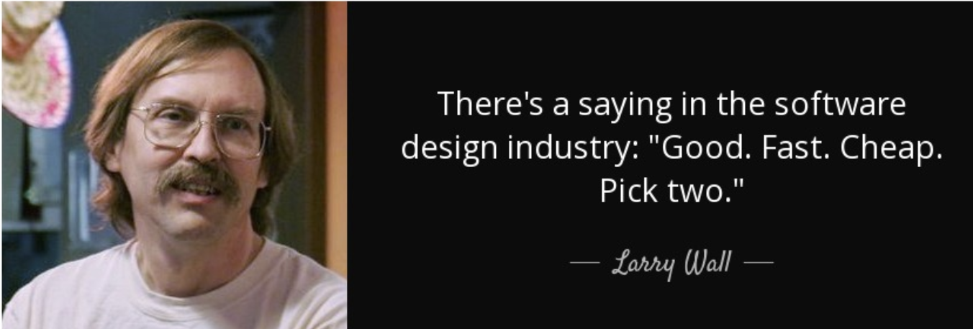

Slide 6
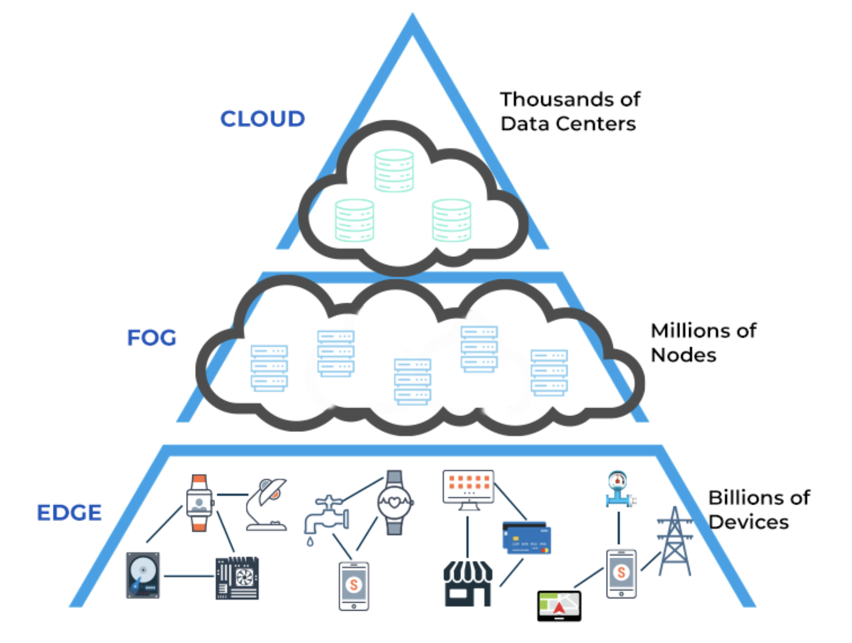
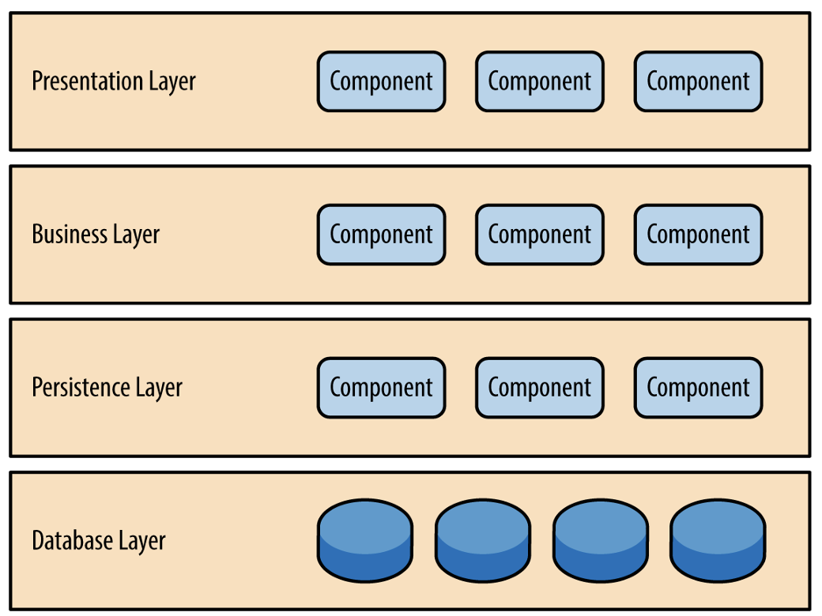

Slide 7
Web Application Firewall
Web Application Firewall
Web Application Firewall
API Gateway
API Gateway
API Gateway
POD
Layer 7 Load Balancer
Managed Kubernetes
Serverless (eg, Lambda)
Virtual Machine Hosted APIs
Node
Serverless Config
Auto Scaling Group
Serverless Function
Container Hosted API
Managed Elastic Cache
Managed Elastic Cache
Managed Elastic Cache
Scale Up/Down Time: Minutes
Warm Up Time: 0
Resiliency Approach: Health Checks Failure Detection Time: Seconds Cost Control: Predictable
Cost to Run: $$$$ Engineering Effort: Significant
Scale Up/Down Time: Seconds (2-3)
Warm Up Time: 0
Resiliency Approach: Kubernetes Failure Detection Time: Milliseconds Cost Control: Predictable & Controllable Cost to Run: $$ Engineering Effort: Moderate
Scale Up/Down Time: Low Milliseconds
Warm Up Time: varies, generally ms.
Resiliency Approach: Serverless Failure Detection Time: N/A, basically 0 Cost Control: Some effort to control
Cost to Run: $ - $$$$ Engineering Effort: Trivial

